Slide 1
BELLZA WEBAPP
Software Engineering final presentation
Group 9

Slide 2
Overview
Purpose: The project aims create an interactive webapp to book saloon appointments.
Goals: The goal of this application is to ease the process of booking saloon appointments in a very effective manner.
Environment:

Slide 3
DEVELOPMENTAL PHASE

Slide 4
SDLC Model
Agile
Incremental and iterative
SCRUM model: best for the given project within the given time limit

Slide 5
Main modules
Login | Live Status | Later Status | Booking | Manager
Google API | Details Required: Date and Time of booking | Details Required: Date and Time of booking | List Services | View Current Status
Virtual Table | Display: Live status of the seats | Display: Later status of the seats | Option to book a latter appointment | Manage bookings
 | Option to instantly book a seat | Option to book a seat | book instantly | Mail Appointment Details

Slide 6
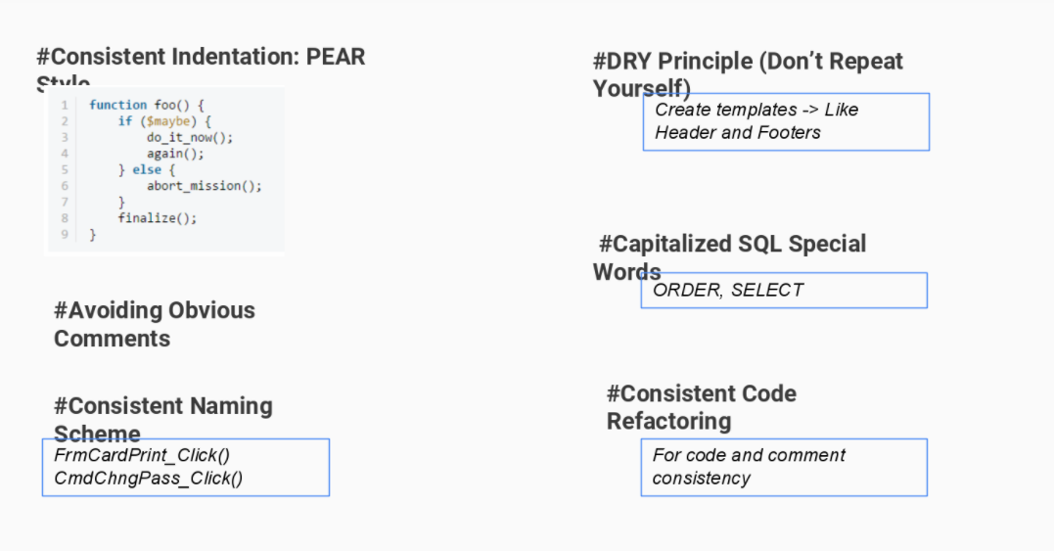
Coding Standards

Slide 7
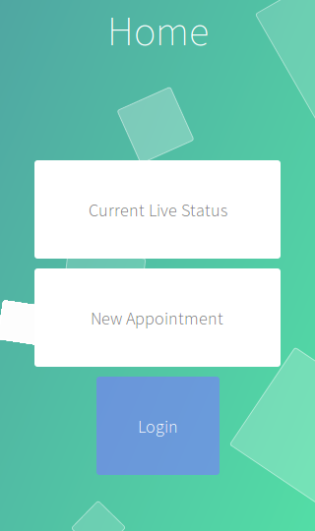
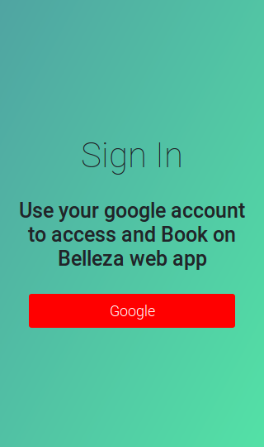
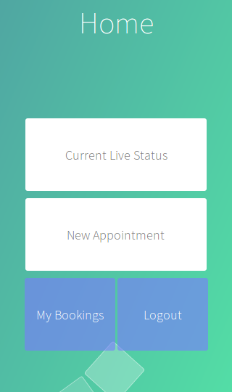
Project Screenshots

Slide 8
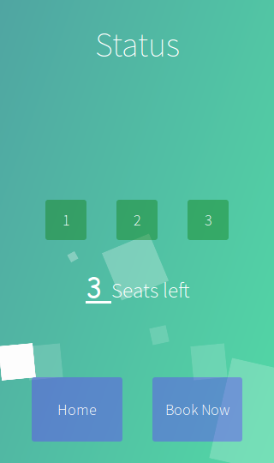
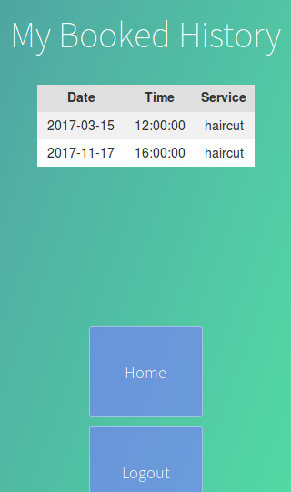
Project Screenshots

Slide 9
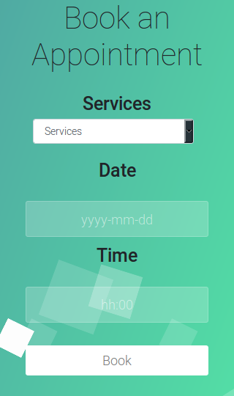
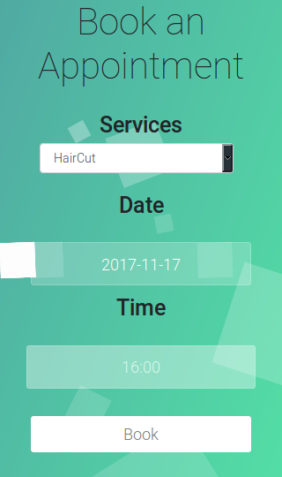
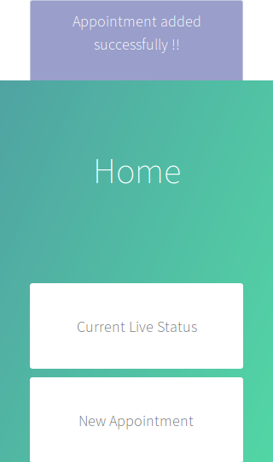
Project Screenshots

Slide 10
TESTING PHASE

Slide 11
Testing Phase
UNIT TESTING
SYSTEM TESTING
FORCED ERROR TESTING

Slide 12
Unit Testing

Slide 13
System Testing

Slide 14
Forced Error Testing

Slide 16
Requirement traceability matrix

Slide 17
TEAM ANALYSIS

Slide 18
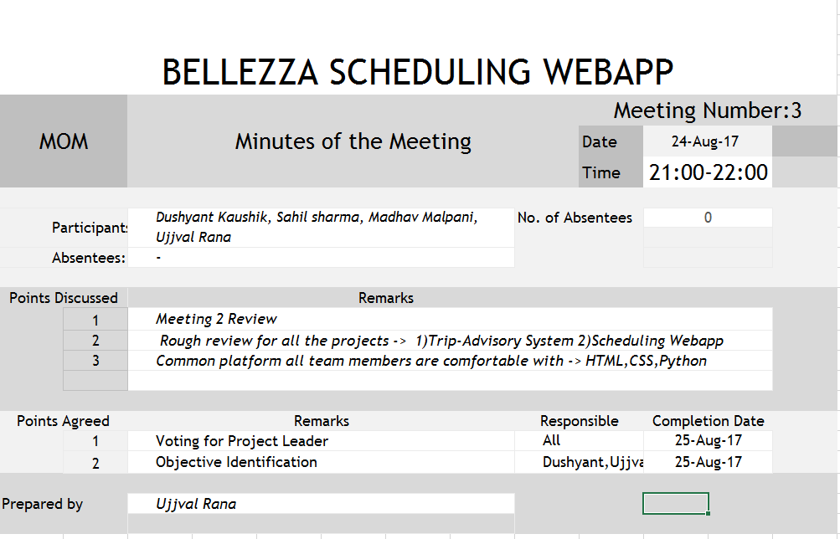
Glimpses of MOM

Slide 19
Tools used by team
Github
Atom Editor
Teletype
Smartdraw
Microsoft Excel, Powerpoint
Bootstrap
Git-bash

Slide 20
Maintenance
Code Cleaning
Document maintenance
Google API update
Changing the code as per client request

Slide 21
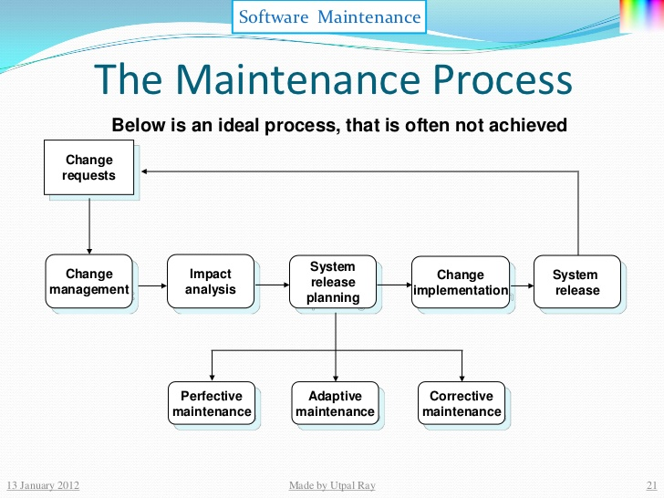

Slide 22
Future aspects
Technical
More secure and efficient environment
Database upgrade
Additional features
Auto-suggestion, integrated payment, packages
Economical
More feasible
More user friendly
Privacy
Becoming more independent
Removing external reference and APIs usage

